Slide 1

DIRECTORATE OF ONLINE EDUCATION
SRM INSTITUTE OF SCIENCE AND TECHNOLOGY
KATTANKULATHUR- 603 203
MCA IV SEM
PROJECT VIVA VOCE
December 2024
ENROLMENT NUMBER : EC2332251010137
NAME OF STUDENT: BHASKAR SARMA PATRAYADI

Slide 2
Optimizing Deep Learning Techniques for Enhanced Real-Time Object Detection
PROJECT GUIDE : Dr.G.Babu

Slide 3
CONTENTS
Abstract
Introduction
Project Scope
Product Functions
Features
Module Description
System Requirements
Existing System
Proposed System
Data Flow Diagram
Workflow
Sequence Diagram
Output Screenshots
Source Code
Conclusion
Feature Enhancements

Slide 4
ABSTRACT
Project Overview: Optimize deep learning models using MATLAB, Python, and advanced libraries for efficient real-time object detection, focusing on deployment to devices like Raspberry Pi for social distancing monitoring.
Deep Learning Intro: Deep learning transforms real-time object detection, essential for tasks like social distancing, with challenges in optimizing for resource-limited devices like Raspberry Pi.
Objective: Create optimized models for real-time detection, targeting practical uses such as social distancing.
Methodology:
Develop models with MATLAB and Python.
Integrate libraries: Intel MKL-DNN, NVIDIA cuDNN, ARM Compute Library.
Apply optimization techniques: pruning, quantization, and lightweight architectures.

Slide 5
ABSTRACT
Analysis:
Assess model complexity and computational needs.
Evaluate hardware capabilities: CPUs, GPUs, ARM devices.
Investigate real-time processing solutions, including edge computing.
.
Workflow
Data Collection: Compiled a dataset from real-time video feeds for object detection, focusing on social distancing.
Model Optimization: Developed and refined deep learning models in MATLAB and Python using pruning and quantization for better performance.
Library Integration: Used Intel MKL-DNN, NVIDIA cuDNN, and ARM Compute Library to boost computational speed and deployment efficiency.

Slide 6
ABSTRACT
Embedded Deployment: Deployed optimized models on Raspberry Pi for efficient real-time processing in limited-resource environments.
Edge Computing: Applied strategies to minimize latency and boost system responsiveness for immediate data processing needs.
Application Development: Customized detection systems for specific uses, like social distancing, to ensure precise distance measurement.
Performance Evaluation: Assessed system performance to establish operational benchmarks for real-time applications.
Data Visualization: Used visualization tools to clearly present detection results, facilitating communication and analysis.
Real-World Impact: Showcased the benefits of optimized models in enhancing object detection capabilities for practical applications.

Slide 7
INTRODUCTION
Overview of the Project
Development of an Optimized Object Detection System for real-time applications.
Purpose and Significance
Enhance the efficiency and accuracy of object detection, especially for social distancing monitoring. Facilitate deployment on embedded devices like Raspberry Pi.
Project Scope
Optimize deep learning models using MATLAB, Python, and advanced libraries. Deploy solutions on resource-constrained platforms for real-time processing.
Expected Outcomes
Improved real-time object detection with minimal computational resources. Efficient deployment on embedded systems for practical applications.

Slide 8
PROJECT SCOPE
Create DL Network
Quantize Network
Take Advantage of ACL (ARM Compute Library)
Use Embedded Cooder and Raspi
Use Codegen in MATLAB to generate optimized Code
Run the PIL and Retrieve the data
Use dlquantizer in MATLAB to quantize the network
Use ACL to use optimized ARM intrinsics (NEON intrinsics) and ARM assembly instructions
Use dlquantizer in MATLAB to quantize the network
Use codegen in MATLAB to generate code for the inference of TFLite Model for pose-estimation network.
This command generates PIL executable on MATLAB
Run the PIL on MATLAB which internally calls the executable generated on Raspi hardware which performs the pose-estimation.
The output is retrieved back to MATLAB
Create the Deep Learning network using dl network designer in MATLAB
Use dlquantizer in MATLAB to quantize the network

Slide 9
PRODUCT FUNCTIONS
Create a Deep Learning Model for Object Detection (MATLAB/python)
Quantize the Model
(fp32 -> int8)
Use the ARM Compute Library
Generate the Optimized Neon Intrinsic Code
Use Embedded Coder and Raspi HSP to generate the PIL
Use Codegen Command in MATLAB
PIL is generated and Code gets Copied to Raspi
Run on Raspi
Retrieve The Output
Functional Hierarchy Diagram

Slide 10
PRODUCT FUNCTIONS ( Run on Raspi)
Capture Live Camera Feed
On the Hardware
Run the Optimized Code for Real Time Social Distance Detection
Get the Bounding Boxes
Get the relevant bounding boxes based on threshold
Send to the MATLAB through Raspi HSP in MATLAB
Functional Hierarchy Diagram

Slide 11


FEATURES
Seamless process in creation and quantizing Network
Used dlquantizer (MATLAB) to convert the floating point model to quantized fixed point model more suited for embedded devices.
Seamless Optimizations using ACL
Leverage ARM NEON intrinsics for inference of quantized TFLite Model
Easy to generate Optimized code using Embedded Coder
With Optimized inference code along with pre and post processing, Any video can be used for pose estimation on embedded hardware

Slide 12
FEATURES
Reduced Manual Copying to hardware and retrieving the output
Using Raspi HSP to avoid manual copying to hardware and generates PIL which runs and retrieves output back to MATLAB.
Real Time Performance for Object Detection
.Real time performance (Better FPS for pose detection)
Seamless Deployment to Embedded Devices
Deploy Code to Raspi using HSP and Easy Run and Retrieve Data using PIL
Easy Visualize the Output Data
Use MATLAB tools to visualize the pose detection of live video/ existing video

Slide 13
MODULE DESCRIPTION
Following are the modules and work involved in each module. In this project the modules correspond to the use cases of this project.
S.No | Module
1 | Create DL Network
2 | Quantize DL Network
3 | Generate ACL optimizations
4 | Use EC and Raspi HSP to Generate PIL
5 | Use Codegen Command to Generate PIL
6 | Visualize the Data
Read Websites Configurations:
Capture Video Feed.
DL network is used to detect people in video feed.
Use ACL optimizations to convert in bird eye view and identify distance
Give bounding boxes of people not compying social media norms.

Slide 14
MODULE DESCRIPTION
Following are the modules and work involved in each module. In this project the modules correspond to the use cases of this project.
Create DL Network:
Create DL Network for Object detection using dlnetwork.
(or)
Pretrained TFLite Models can be imported.
Quantize DL Network:
Using dlquantizer, Models can be quantized from floating point to fixed point models..
Generate ACL optimizations:
ARM provides ACL library which has set of ARM Compiler Assembly and Intrinsic SIMD NEON optimized instruction set.
Using Codegen in MATLAB, we can leverage ACL optimizations
Using TensorFlow Lite Library , we can also leverage Google TensorFlow Optimizations which can be targeted on Embedded Devices.

Slide 15
MODULE DESCRIPTION
Following are the modules and work involved in each module. In this project the modules correspond to the use cases of this project.
Use EC and Raspi HSP to Generate PIL:
HSP provides an easy way of communicating with hardware and easily retrieve the data back and forth.
Embedded Coder (EC) generates optimized code for Embedded devices.
Embedded Coder creates PIL interface which calls the executable on hardware and retrieves the output.
Use Codegen Command to Generate PIL:
Codegen command generates optimized C code for MATLAB code targeted for hardware.
It uses ACL library for NEON optimizations on ARM hardware.
Visualize the Data:
Run the PIL to run executable
Should allow the users to initiate an extraction process and view the progress

Slide 16
SYSTEM REQUIREMENTS
Processor | Intel Core i5 or more / AMD Ryzen 5 or more
RAM | 16 GB Or more
Hard Disk | 20 GB or more
Monitor | 15” colour monitor or better
Keyboard | Any Keyboard
Mouse | Any mouse
Printer | In case of printing the graphs or filtered data
Network | Not needed
Processor | Rasperry Pi 4
RAM | 4 GB Or more
Hard Disk | SD card 32 GB
CPU | Quad-core ARM Cortex-A72 (64-bit) at 1.5 GHz
GPU | Broadcom VideoCore VI, OpenGL ES 3.0 support
Monitor | Optional
Camera | Raspberry Pi 5 MP camera module
Network | Needed while setup
Software Needed | MATLAB, Embedded Coder Products Raspi HSP
Operating System | Windows / Linux / Mac
Licensing | MATLAB and Embedded Coder License and Deep Leaning Toolbox License
Hardware Requirements
Host Requirements

Slide 17
EXISTING SYSTEM
Manual Process
Manual Effort in Optimizing Code
Manually Optimize using ARM Assembly Intrinsics
Write a script for Quantizing Model
Manual Copying To Hardware
Have to manual copy code to hardware
Retrieve output is difficult and have to manually handle output store and copying
Difficult to Deploy and Achieve Realtime Performance
Create a Makefile manually tp create EXE on the hardware
Human error prone process
Need to handle optimizations, deployment and codegen process.

Slide 18
PROPOSED SYSTEM
Quantize
Quantize the TFLite Model
Optimize
Deploy
Uses Raspi HSP to easily deploy and retrieve the output
Optimize the Code using ARM intrinsics using ACL and EC
Fully Automated Process
A fully automated software process will Quantize the model
Capture data or use pre captured data
Use EC to Optimize the Code leveraging ACL library
Use HSP to deploy the Network Inference along with pre and post processing.
Easily retrieve the output along with post processing to host.

Slide 19
Social distance detection system workflow
Detection of people in live video using tfLite object detection network.
Determining the centroids for each detected person
Computing the pairwise distances between all centroids
Alert when pair wise distance < 6 feet apart
1
2
3
4

Slide 20
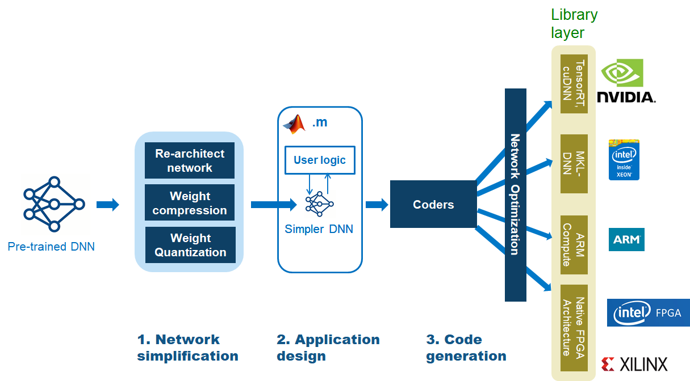
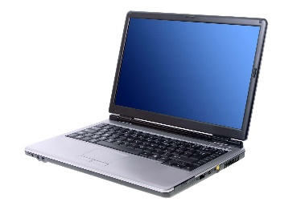
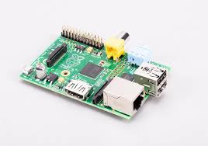
DATA FLOW DIAGRAM (DFD)
Host
Raspi Hardware

Slide 21

Seamless Workflow
Whole application with trained DL network
.m
capture
Pre-processing
Post-processing
codegen
deploy
Raspi Hardware

Slide 22


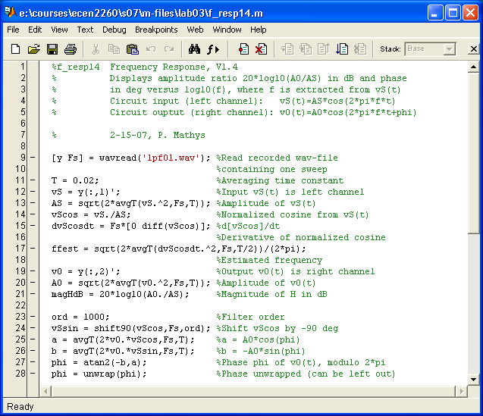

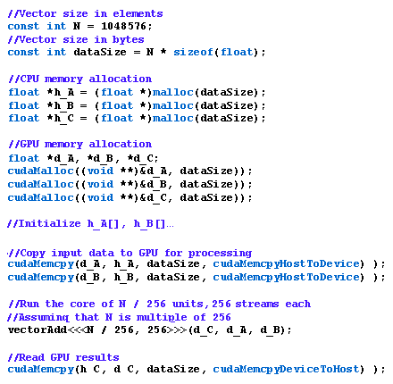
Sequence Diagram
Functional algorithm
Generate PIL with TFLite Model Inference and Pre and Post Processing
Copy the code to the Hardware
Capture the Video Frame for Object Detection
Generate the code using Optimized ARM Neon intrinsics
Detects People
Identify Distance between People
Check if They are complied to Norms
Run the PIL which runs exe on hardware
Retrieve Output Back to Host

Slide 23
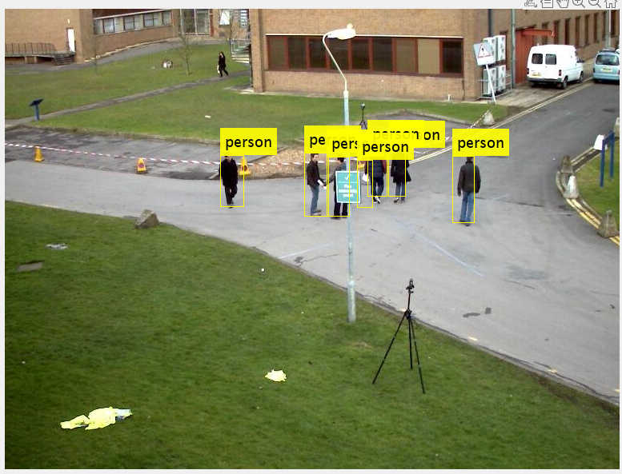
Step 1- Detection of people using Quantized Object detection Model on Raspi HW
Output Screenshots

Slide 24
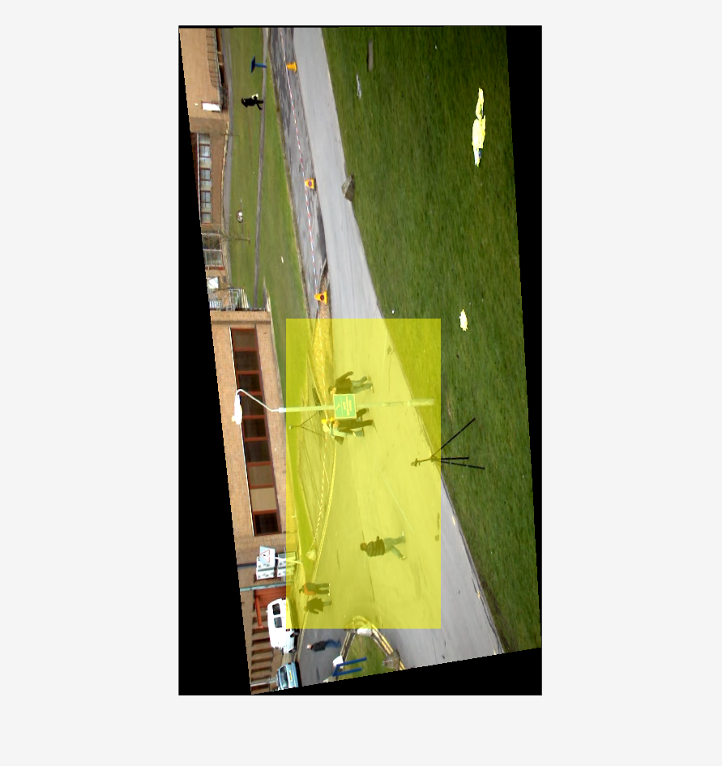
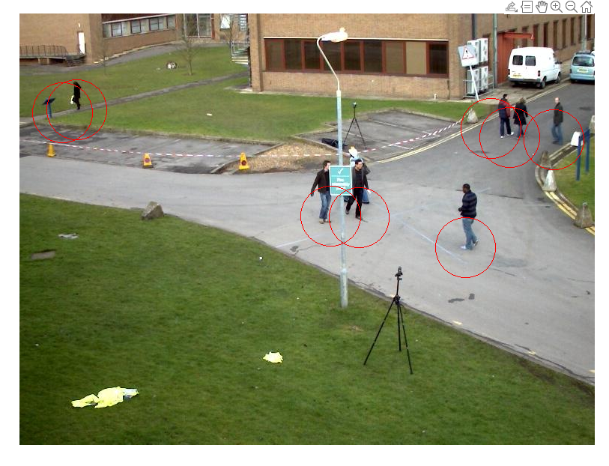
Step 2- Determining the centroids for each detected person using Bird Eye View
Output Screenshots
Step 2- Convert to Bird Eye View

Slide 25
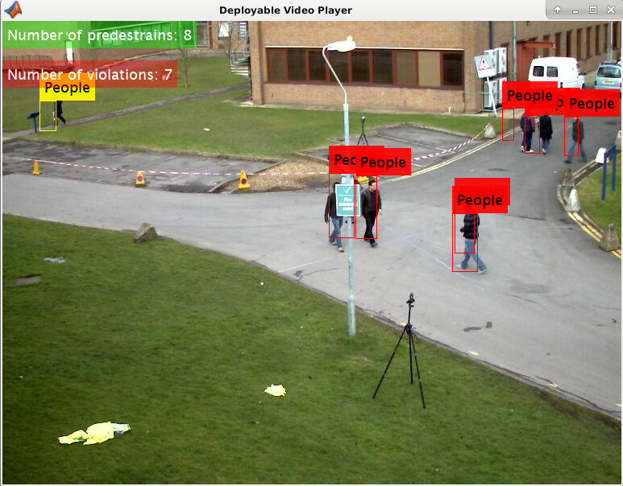
Output Screenshots
Step 3- Computing the pairwise distances between all centroids and mark as red when distance < 6feet

Slide 26
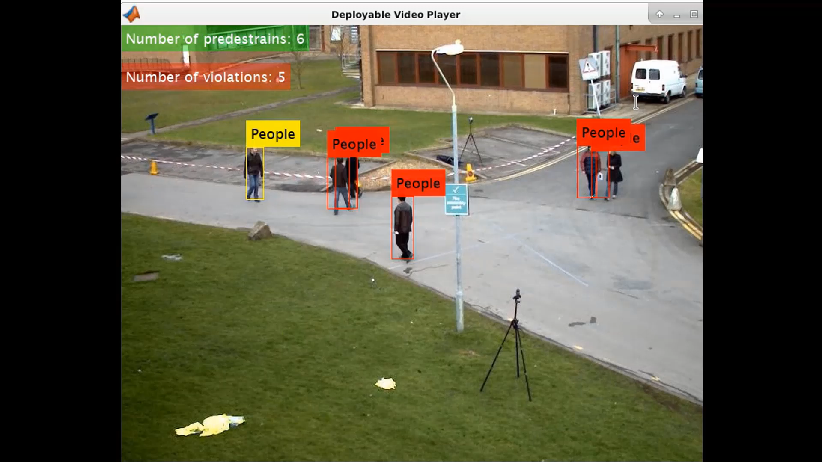
Output Screenshots - Demo

Slide 27
SOURCE CODE – GITHUB LOCATION
The Complete Source code is found in the following GitHub location: https://github.com/vyshnavijayanthiMBAHR/MBA_4thSemProject_VyshnaviHR_SRM.git

Slide 28
CONCLUSION
Summary of Findings
Successfully optimized deep learning models for real-time object detection on embedded devices.
Achieved efficient deployment on Raspberry Pi, focusing on social distancing applications.
Enhanced system performance through model pruning, quantization, and library integration.
Benefits of the Approach
Efficiency and Accuracy: Improved detection accuracy and processing speed in resource-constrained environments.
Real-Time Capability: Enabled immediate data processing and decision-making with edge computing strategies.
Implications for Real-Time Object Detection
Develop automated systems for continuous monitoring and reporting.
Facilitate strategic decision-making with real-time insights and performance benchmarks.
Enhance operational efficiency in diverse fields such as public safety and autonomous systems.
.

Slide 29
FUTURE ENHANCEMENTS
Advanced Model Optimization
• Explore cutting-edge optimization techniques like neural architecture search to further improve model efficiency and accuracy.
Broader Device Support
• Extend deployment capabilities to a wider range of embedded devices and platforms, enhancing versatility and scalability
Enhanced Edge Computing:
• Develop more sophisticated edge computing strategies to further reduce latency and improve real-time processing capabilities.
Comprehensive Testing:
• Conduct extensive field testing to validate system performance in diverse environmental conditions and scenarios.

Slide 30
REFERENCES
Libraries
Intel MKL-DNN. Documentation and resources available at: Intel MKL-DNN
NVIDIA cuDNN. Documentation and resources available at: NVIDIA cuDNN
ARM Compute Library. Documentation and resources available at: ARM Compute Library
TensorFlow Lite Documentation and resources available at: TensorFlow Lite
Books and Publications
Goodfellow, I., Bengio, Y., & Courville, A. (2016). Deep Learning. MIT Press.
A comprehensive resource on the foundations and advancements in deep learning.
Redmon, J., & Farhadi, A. (2018). YOLOv3: An Incremental Improvement. arXiv preprint arXiv:1804.02767.
Discusses the YOLO (You Only Look Once) model, a popular choice for real-time object detection.
Technology references
Complete Source code is found in the following GitHub location: https://github.com/vyshnavijayanthiMBAHR/MBA_4thSemProject_VyshnaviHR_SRM.git
https://www.mathworks.com/products/matlab.html
https://www.tableau.com/learn/articles/data-visualization
Raspberry Pi Documentation
TensorFlow Lite

Slide 31

THANK YOU

